Slide 1
Azure Cosmos DB Programming

Slide 2
Which Cosmos DB API should we choose?

Slide 3


For all new workloads – Core (SQL) API
Best developer experience – Cosmos DB PG builds interface, service, and SDKs
For graph data: Gremlin API
Other APIs for migration from that data store
Core (SQL) API
MongoDB
Table API
Column-family
Document
Key-value
Graph
Notes:
This slide based on a slide from Deborah Chen’s Ignite 2019 session https://myignite.techcommunity.microsoft.com/sessions/81002

Slide 4
After we choose the API for our Cosmos DB account…
how can we use Cosmos DB in our code/apps?
APIs
Languages
SDKs
ORMs
Drivers
Integrations

Slide 5
APIs | 1 |
Cosmos DB provides REST APIs to manage and query Cosmos DB resources.
Careful – terminology overload: “API”
Account APIs = compatibility, storage format; SQL, MongoDB, Cassandra, etc.
REST APIs = programmability from anything that speaks HTTP/REST
Two separate REST APIs:
“REST API” for working with resources and data in a Cosmos DB account
“Resource Provider API” for working with accounts and keys

Slide 6
APIs | 2 | REST API
Reference: https://docs.microsoft.com/rest/api/cosmos-db/
Work with resources in a Cosmos DB account
Databases, Collections, Documents, Sprocs, UDFs, Documents, Queries
Can NOT create/manage Cosmos DB accounts or keys with this API
SQL API only! (Against other APIs = 404/failure)
Use the account endpoint: https://youraccount.documents.azure.com
Built on the .NET SDK v2: https://github.com/Azure/azure-cosmos-dotnet-v2
Do you need to care? No – the API itself is pure HTTP/REST
I.e. the underlying technology doesn’t matter to the API consumer
Dive into SDK source code only if care about internal details

Slide 7
APIs | 3 | Resource Provider (RP) REST API
Reference: https://docs.microsoft.com/rest/api/cosmos-db-resource-provider/
Work with Cosmos DB accounts and keys
For other tasks, use the REST API (previous slide)
All Cosmos DB APIs supported
Endpoint: the Azure management API itself
https://management.azure.com/subscriptions/{subscriptionId}/resourceGroups/{resourceGroupName}/providers/Microsoft.DocumentDB/databaseAccounts/{accountName}/...?api-version=2020-04-01
Other layers (SDKs, Azure CLI, Azure Portal etc.) use this RP API

Slide 8
APIs | 4 | So - should you use the REST APIs?
Yes, if…
Working in a language without an SDK or other Cosmos DB library/package
No other library, driver, or ORM available
Need to avoid using SDK/library/package
Want to get as “bare metal” as possible
Want to re-implement SDK capabilities
Want to experiment/learn
No, because…
Cosmos DB engineering creates SDKs – significant dev/test resources
SDKs incorporate best practices
SDKs include cross-cutting concerns like error handling, logging
SDKs handle retry, parallelization, network traffic optimization, bulk, batch, more
SDKs heavily tested, optimized, supported
SDKs are OSS on github – can inspect, file issues, even contribute!
Summary: use SDKs when you can, REST API if you must, or to experiment.

Slide 9
Languages
In theory, you can develop in any language! After all, you can always talk REST.
But… in reality, this decision process makes sense:
Which Cosmos DB API shall we use?
Compatibility with any existing codebase? (Mongo DB, Cassandra…)
+ Other considerations: graph data… skillset… hybrid platform…
How can we develop for that Cosmos DB API?
SDKs provided by Cosmos DB PG - .NET, Java, Python, Node.js
For Mongo DB/Cassandra/Graph APIs… use that community/platform’s existing tools
Which of the SDKs/platforms/languages makes sense for us?
Team / partner skills, budget, etc.
Other applications, integrations, drivers, etc.

Slide 10
Core/SQL API | 1 | SDKs
.NET SDKs (Framework, Core, Standard)
V2: still supported but do not use for new work
V3: current release – notably, includes bulk support which was separate in V2
V4: preview
Java SDKs
V2: sync and async versions – still supported but do not use for new work
V4: current version
Node.js SDK
Python SDK

Slide 11
Core/SQL API | 2 | ORMs
Microsoft Entity Framework Core supports Cosmos DB
What is EF? A .NET Object-Relational Mapper (ORM) which helps developers write apps to interact programmatically with databases.
Think of it as an abstraction layer that lets developers work with familiar concepts (objects, lists, etc.) instead of “translating” objects to database entities
SQL API Only – and there are Limitations
Third Party
Hibernate (Java, with JDBC driver e.g. from cdata)
Cosmonaut and CosmicGraph (these use .NET SDK V2 and are not actively maintained)

Slide 12
Sidebar - About ORMs
ORMs used with RDBMS to solve “object-relational impedance”.
NoSQL/Document databases: easy to store serialized entity → less need for ORMs.
In C#/.NET: object → JSON in one line of code:
string myDocument = JsonConvert.SerializeObject(myObject);
Then write document to Cosmos DB. No mapping to relational schemas!
(But we may still need to think about embedding vs. referencing.)
Major ORMs are traditionally relational-centric. NoSQL database support is limited.

Slide 13
MongoDB API | 1 |
PG does not provide SDK. Instead, use:
Official drivers provided by MongoDB
13 officially supported libraries including .NET/C#, Java, Go, Node.js, Python, Rust
CData drivers – specifically for Cosmos DB accounts with MongoDB API
Mongoose – Node.js object-database mapper (see how-to guide)
MongoDB is a major growth focus for Cosmos DB PG.
The PG has a MongoDB API PM.
Field can engage GBBs and PG for complex technical situations.
MongoDB very popular with developers, esp. Java.

Slide 14
MongoDB API | 2 |
The idea: Cosmos DB MongoDB API account can be substituted for a MongoDB instance – change nothing in your code!
(OK, just the connection string.)
Does this always “just work”? …
Cosmos DB accounts support MongoDB 3.2, 3.6, 4.0 and 4.2
MongoDB has since released 4.4 and 5.0
Why the lag? Effort to map protocol to Cosmos DB “under the hood”.
If a customer needs > 4.2 – consult PG for version roadmap.
Not all Mongo commands are supported; review and test early!!
Docs have troubleshooting/how-to. PG/GBBs can help with complex questions, e.g. “Will a query with several OR predicates use more than one index, if defined?

Slide 15
Cassandra API
PG does not provide SDK. Instead, use:
Cassandra drivers from Datastax and gocql
Datastax is commercial Cassandra vendor; has Azure MP offerings
Java, .NET/C#, Node.js, Python, C++, PHP
Gocql is OSS: Cassandra client for Go
Spring Data
Spring is a major Java framework
Cosmos DB Cassandra API supports CQL v4 wire protocol
Any client driver that understands CQL v4 should be able to connect
Carefully review supported Cassandra data types, CQL functions, and limits!
Also review differences: many are ++ for Cosmos DB!
The PG has a Cassandra PM

Slide 16
Gremlin API
Gremlin API based on Apache Tinkerpop graph database standard.
Uses Gremlin query language to interact with data.
Use Gremlin API for compatibility, or to implement a graph-capable application.
PG does not provide SDK.
Use a compatible client library from Apache or a third party. (PG recommends drivers supported by Apache Tinkerpop.) Can also use Spring Data.
Careful! Review Cosmos DB Gremlin compatibility and limits!

Slide 17
Table API
Table API is for apps written to use Azure Table Storage.
PG provides SDKs for .NET/C#, Java, Python, and Node.js. The Azure Storage REST API for Table is also supported.
Recommended to use the Cosmos DB-specific SDKs rather than Azure Storage SDKs.
Carefully review the differences between Azure Table Storage and Cosmos DB Table API, as well as the benefits of Cosmos DB Table API. Examples:
Table API latency up to 10 seconds vs. Cosmos DB standard ms latency guarantees
Cosmos DB global distribution capabilities vs. Table primary/secondary region
Other Cosmos DB capabilities like indexing, granular consistency, etc.

Slide 18
Bulk Ingest | 1 |
Bulk ingest is needed to ingest large quantities of data fast, at reasonable cost. Java and .NET SDKs support it.
Consider pre- and post- steps:
Pre: turn off indexing – boosts ingest speed since indexing is synchronous
Post: turn indexing back on – still take time to “catch up” but at least ingest is done
Bulk ingest can increase request latency. Not for “normal” transactional scenarios.
PG improving perf: example https://github.com/Azure/azure-cosmos-dotnet-v3/pull/1640
So don’t turn it on unless you need it.

Slide 19
Bulk Ingest | 2 |
Full tutorial here:
https://docs.microsoft.com/azure/cosmos-db/tutorial-sql-api-dotnet-bulk-import
Code sample at:
https://github.com/Azure-Samples/cosmos-dotnet-bulk-import-throughput-optimizer
This code sample deploys a container with an indexing policy that excludes all paths to optimize bulk ingest performance.

Slide 20
What tools can we use?

Slide 21
Tools – Summary/List
Cosmos DB notebooks – and github!
Visual Studio Code
vscode-cosmosdb extension
Cosmos DB trigger bindings for Azure Function projects
Visual Studio 2017+ has Azure Function project template, deploy/publish
Cosmos DB Emulator
Azure DevOps Build task with Cosmos DB Emulator
Azure portal Data Explorer and https://cosmos.azure.com
Azure Storage Explorer

Slide 22
Cosmos DB Notebooks
Cosmos DB has built-in Jupyter notebook support
Audience: data scientists, devs comfortable with notebook/REPL
Integrated into Azure portal → Azure Cosmos DB account
Python and C# notebooks for all Cosmos DB APIs
Distinct from Synapse notebooks that connect to Cosmos DB Analytical Store
Cosmos DB notebooks use Spark compute in Cosmos DB account, or can use a Spark cluster provisioned in Synapse (if Synapse Link is enabled)
Use notebooks from local computer, or connect account to github repo
Both public and private github repos supported
Notebook saves get pushed to github! (Super easy experience)
Can import notebooks from Cosmos DB notebooks gallery → examples
NOTE: preview. Data Explorer or github connection may need occasional refresh.

Slide 23
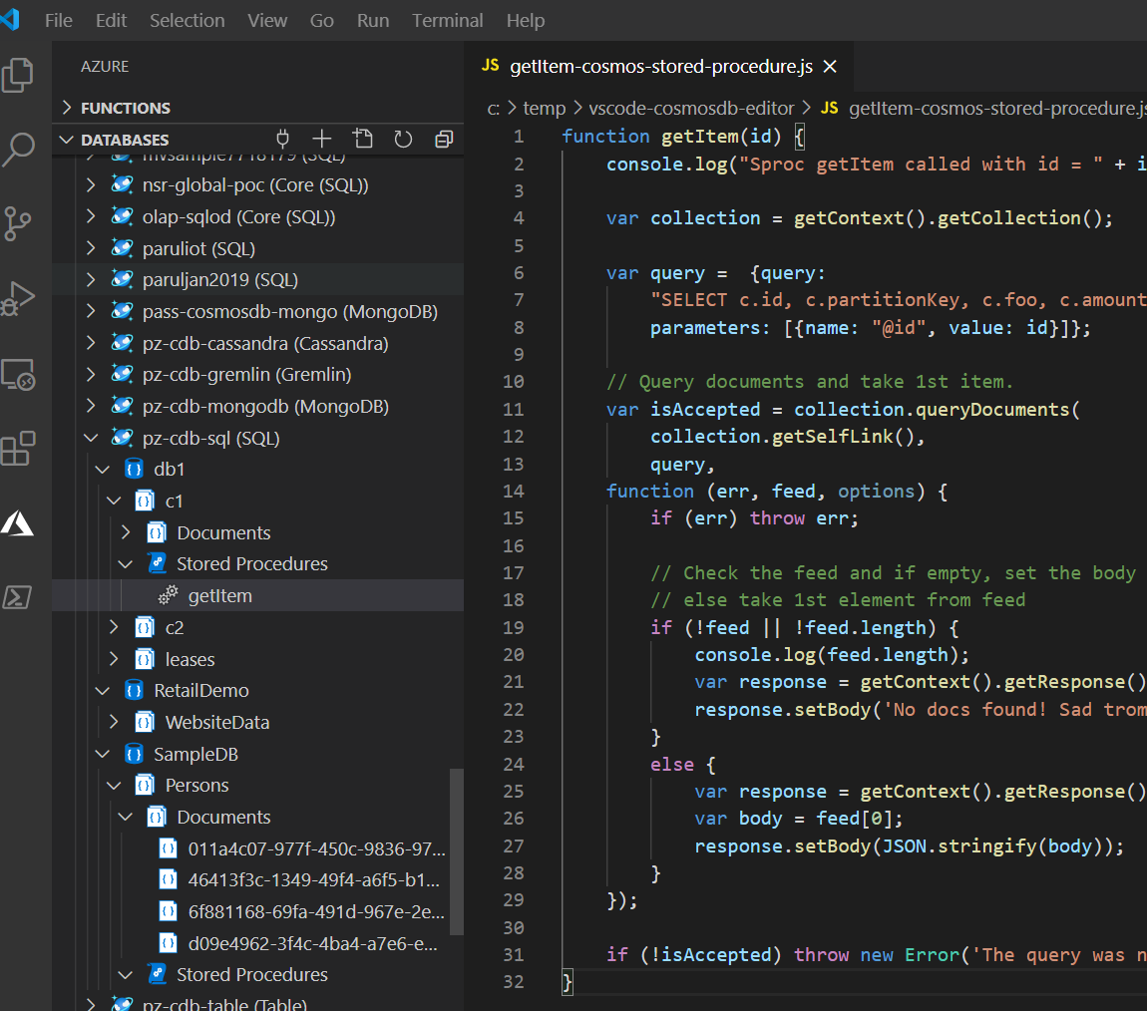
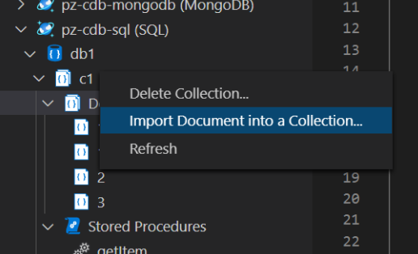
VS Code | 1 | Azure Databases Extension
Azure Databases extension (vscode-cosmosdb)
Connect to Azure Cosmos DB accounts, databases, collections
Import and edit documents; edit stored procedures

Slide 24
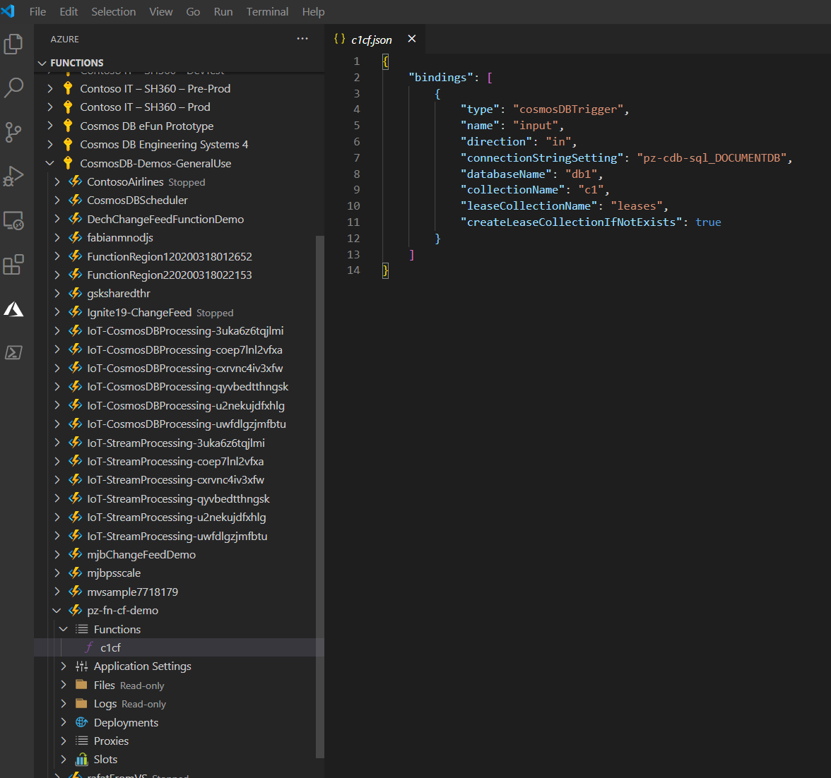
VS Code | 2 | Azure Functions extension + Cosmos DB Trigger
Azure Functions extension
Azure Functions Core Tools also needed to debug locally
Use extension to create Function project and Cosmos DB trigger
Configure Cosmos DB account, database, and collection to listen to
Connect to Change Feed for that collection
Deploy to Azure App Service / Function App
Debug locally

Slide 25
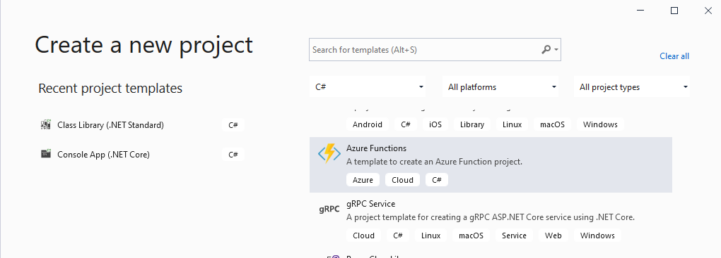
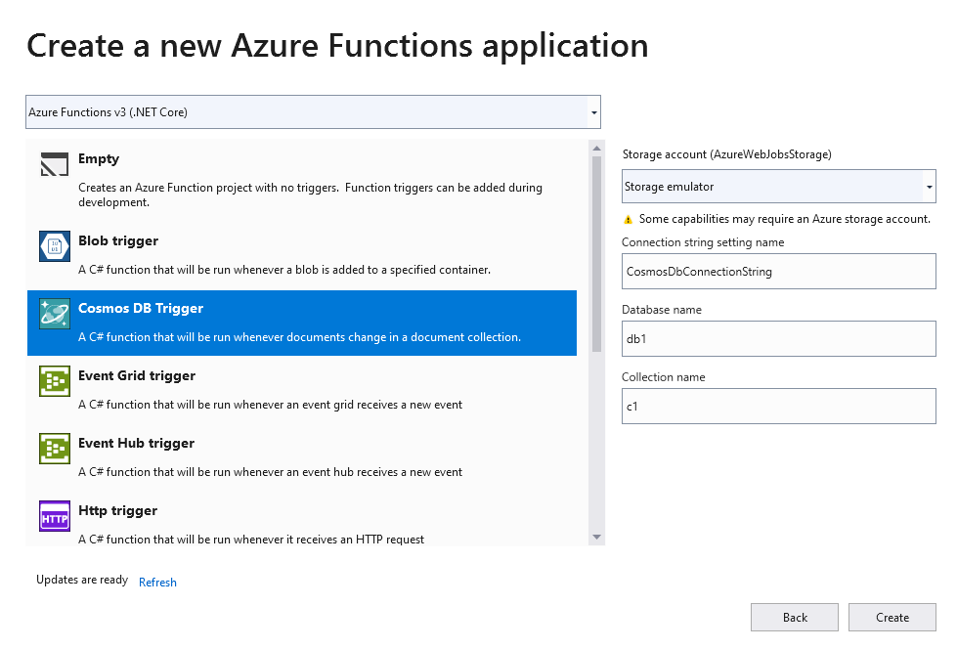
Visual Studio | 1 | Azure Function template
Requires Azure Development Workload installed (VS Installer)
Azure Functions project type

Slide 26
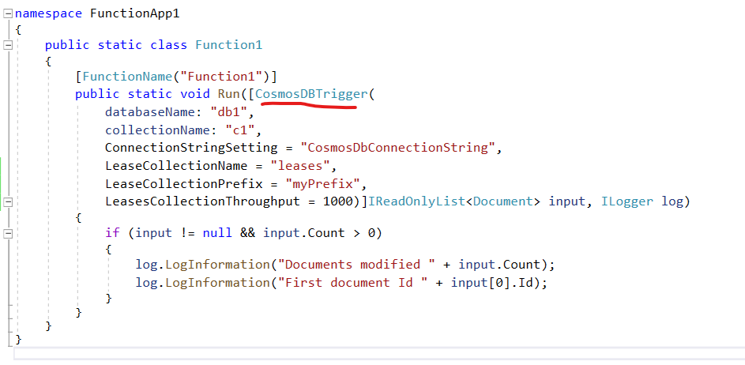
Visual Studio | 2 | Cosmos DB trigger
CosmosDBTrigger attribute
Allows for lease collection configuration: prefix (→ multiple listeners), throughput

Slide 27
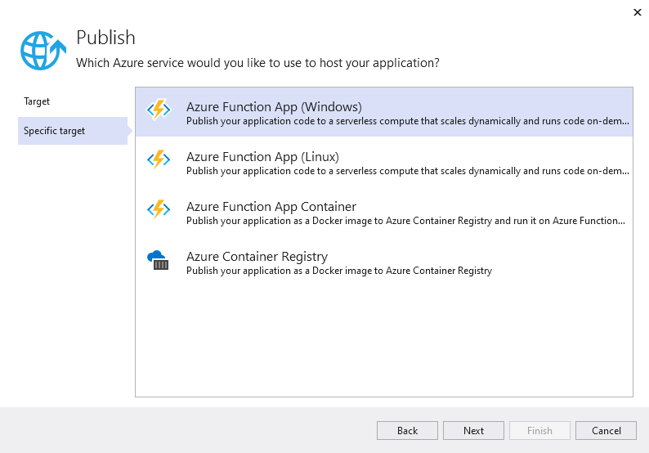
Visual Studio | 3 | Publish/Deploy
Can publish/deploy directly from Visual Studio
Select an existing Function app, or create a new one from Publish wizard
Note: discuss CI/CD pipelines with customers for production scenarios

Slide 28
Cosmos DB Emulator | 1 |
Dev/test for Cosmos DB locally – no Azure sub needed, no cost
Supports all Cosmos DB APIs. Emulator UI data explorer SQL only.
Same functional surface (to your app), but different implementation
For example local filesystem used for storage
Functionality that relies on Azure – e.g. geo-replication, latency guarantees, tunable consistency – not applicable
Can migrate data from Emulator to Azure using Cosmos DB Data Migration Tool
ONLY runs on Windows 10/Server or in Windows Docker container
PG aware of customer interest in other platforms
No immediate plans to provide version for other platforms
Instead: Windows container or Cosmos DB Free Tier
Could also run in Windows VM on Mac or Linux

Slide 29
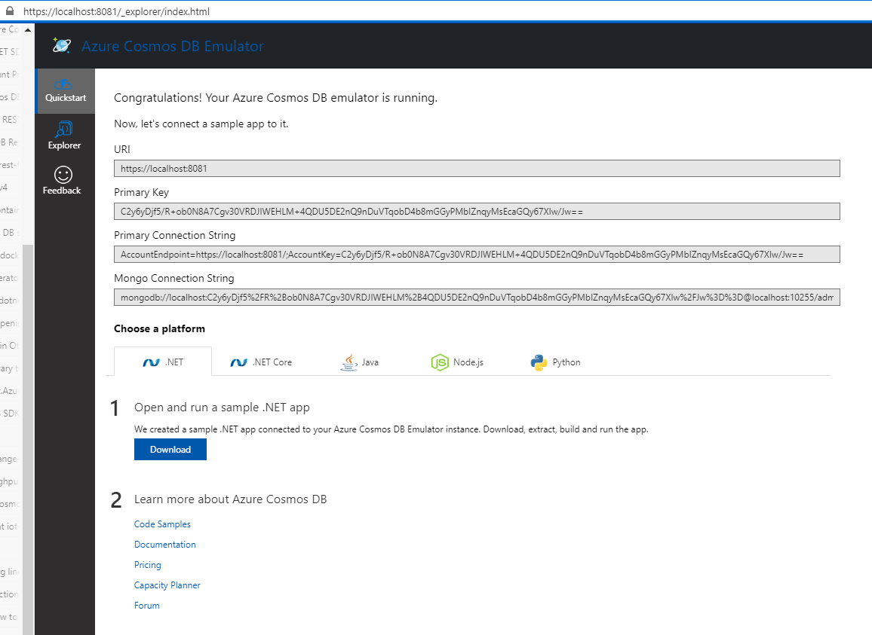

Cosmos DB Emulator | 2 |

Slide 30
Azure DevOps Build Task with Cosmos DB Emulator
Integrate Cosmos DB test into CI/CD pipeline
Deploys a Windows container hosting Cosmos DB Emulator
Available in the Azure DevOps Marketplace – install to DevOps org
Not open source
Released August 2018.
Shows as public preview
Specific settings – read docs on creating a build definition carefully
No github Action support yet

Slide 31
Azure Portal Data Explorer and Cosmos Explorer
Cosmos Explorer is the web-based interface to manage Cosmos DB
Access it at https://cosmos.azure.com
Manage account, databases, containers, partitioning, sprocs, UDFs, indexes, etc.
Set regions, throughput, default consistency level, single vs. multi write, etc.
Work in notebooks, connect to github
Write SQL queries and inspect query metadata
Can access via RBAC or via connection string
Every Cosmos DB account in the Azure portal has Data Explorer
Portal blade in Cosmos DB account – equivalent to Cosmos Explorer
Differences
Cosmos Explorer has full window area; Data Explorer is Azure portal blade
Cosmos Explorer available to users without Azure subscription or portal access

Slide 32
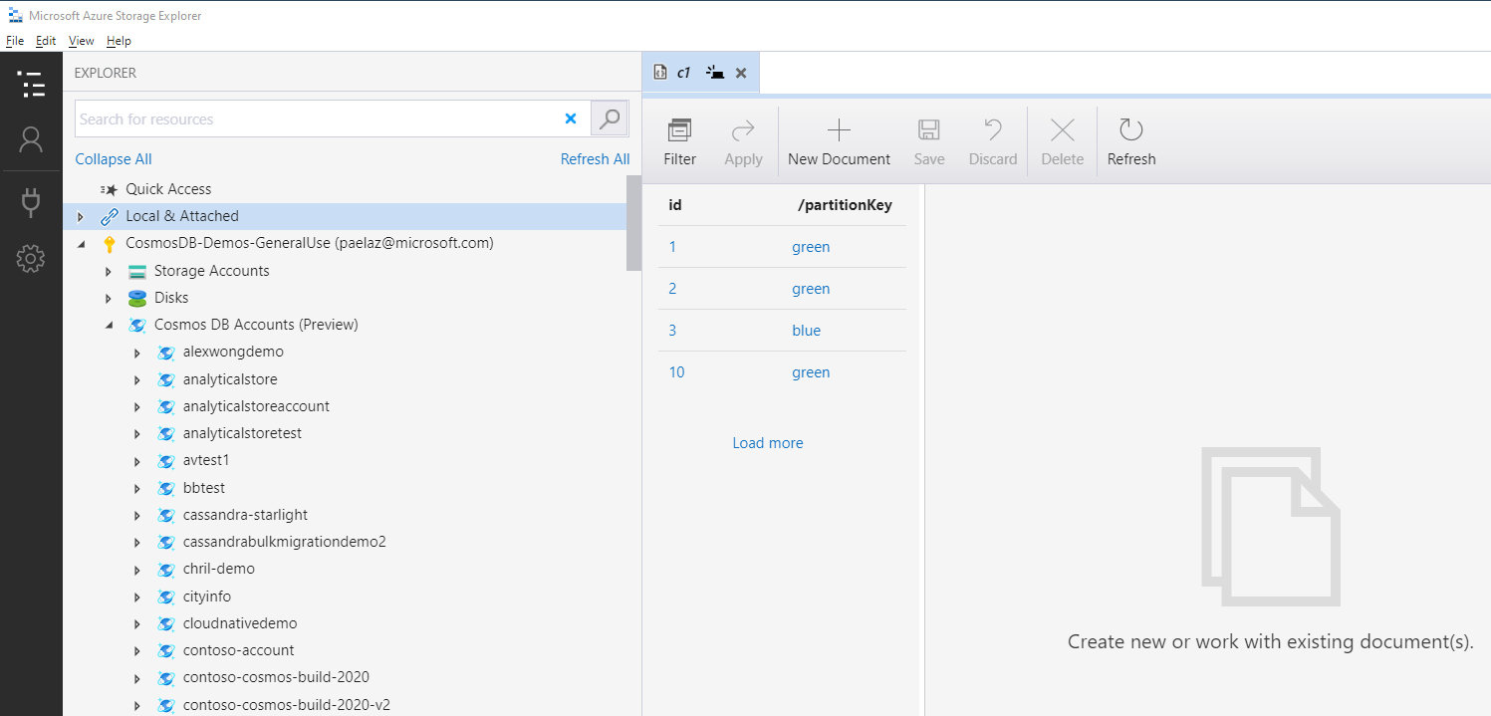
Azure Storage Explorer
Cross-platform desktop tool from Microsoft
Supports Core/SQL, MongoDB, Graph, and Table APIs
Manage Cosmos DB accounts, databases, containers, data, sprocs, UDFs, triggers
Connect accounts via RBAC or connection string

Slide 33
How can we integrate with other workloads?

Slide 34
Azure Synapse Link
Query Cosmos DB Analytical Store from Azure Synapse
To do this, two steps required:
Enable Azure Cosmos DB Account for Azure Synapse Link
Enable Cosmos DB Container for Analytical Store
Audience: developers and data scientists productive with notebooks and Spark (including Databricks)
Developer: write code to query Cosmos DB Analytical Store data in Synapse notebooks (pySpark, Spark SQL) or T-SQL queries (private preview)
Synapse Notebooks support Python, Scala, SparkSQL, and .NET/C#
Can mix languages in the same notebook! But pay attention to the details.

Slide 35
Azure Data Factory (ADF)
Copy and transform data in ADF (remember Synapse Workspace “includes” ADF)
Integrate Cosmos DB data (source or sink) into larger pipelines
Use case: as a developer, I need to programmatically create ADF linked services, datasets, and activities that work with data in Cosmos DB
Core/SQL API and MongoDB API only – other Cosmos DB APIs not supported
ADF SDKs/APIs include .NET SDK, Python SDK, Powershell, REST API
Note: these are ADF SDKs/APIs – not Cosmos DB’s
.NET SDK Quickstart shows use of ADF SDK classes to copy data. This QS shows Azure storage copy, but ADF SDK includes classes for Cosmos DB entities
I.e. you can adapt this Quickstart to Cosmos DB quickly
Core/SQL API classes in ADF SDK: linked service, source, sink, dataset
MongoDB API classes in ADF SDK: linked service, source, sink, dataset

Slide 36
Change Feed | 1 |
Change Feed = sorted list of new and changed documents in a container
Supported for all Cosmos DB APIs except Table API
Supported in all SDKs (.NET/C#, Java, Python, Node.js)
Only most recent version of document *
What does this mean? Say a document has versions d0, d1, d2, d3
If you “start listening” after d2, you will get the d2 and then d3 versions
You will not be able to find d0 or d1 in the change feed *
Deletes NOT included *
What does this mean? Change feed won’t tell you a document was deleted *
Workaround: “soft delete” + short TTL
Update a doc to set IsDeleted:true and set its TTL very low
This will show up in the change feed, AND it will get auto-deleted after TTL
* Until “Full Fidelity Change Feed” becomes available later this year

Slide 37
Change Feed
Persistent log of records within an Azure Cosmos DB container. Preseneted in the order in which they were modified
New Events
Azure Cosmos DB
Change feed

Slide 38


Change Feed Scenarios
Event-Computing and Notifications
Retail, Gaming, Content management
Trigger a call to an API when a document is inserted or modified
Azure functions
Azure Notification Hubs
Azure App Service
Stream processing
IoT processing, Data science & analytics
Perform real-time (stream) processing on updates to data
New Events
Azure Stream Analytics
Azure Databricks
Apache Spark
Apache Storm
Azure Cosmos DB
Change feed
Data movement
Enterprise data management
Move, clone, or archive data to cold storage
Azure Storage Blob
Azure Data Lake
Azure Cosmos DB
Notes:
There are non-dev reasons – e.g. lambda architecture or other data patterns; materialized views; maintain duplicate containers with different partition keys; etc.
Implement software patterns like Event Sourcing and Compensating Transactions
Event Sourcing: append-only store to record sequence of changes to entities
More generally – event-triggered workloads

Slide 39
Event Sourcing for Microservices
Trigger Action From Change Feed
Persistent Event Store
Microservice #1
New Event
Microservice #2
…
Azure Cosmos DB
Change feed
Microservice #N

Slide 40
Materializing Views
Application
Azure Cosmos DB
Materialized View
Subscription | User | Create Date | …
123abc | Ben6 | 6/17/17
456efg | Ben6 | 3/14/17
789hij | Jen4 | 8/1/16
012klm | Joe3 | 3/4/17
User | Total Subscriptions
Ben6 | 2
Jen4 | 1
Joe3 | 1
Change feed

Slide 41
Replicating Data
Secondary Datastore (e.g. archive)
Replicated Records
CRUD Data
Azure Cosmos DB
Change feed

Slide 42
Change Feed | 2 | How to Use
Change Feed has Push and Pull Models
Push = much easier; Pull = more control, more effort
Push: supported to Azure Functions and SDK Change Feed Processor
Azure Functions Cosmos DB trigger binding = Change Feed
Pull: in preview, .NET SDK only. Limited use cases:
Optionally read changes from a specific partition key (also supports whole container, like Push model)
Manage the pace at which changes are processed (e.g. consumer scale/autoscale impractical, etc.)
More responsibility to implement polling for new changes, etc.

Slide 43
Change Feed | 3 | Azure Functions and Change Feed
Azure Function with Cosmos DB Change Feed
Visual Studio (or VS Code) - inspect code
Attach to change feed via method Attribute
Attribute is Cosmos DB trigger binding
Includes configuration capabilities for leases collection
Throughput - will default to 400, may need to set higher (can do later too)
Lease prefix – can set unique prefix per listener to allow multiple listeners to the change feed for a particular container
Azure Portal – in-portal editor
Create a new function with Cosmos DB trigger
Add sample doc → observe Function triggered, write to log
Change Feed Processor – see Azure Samples for runnable demo

Slide 44
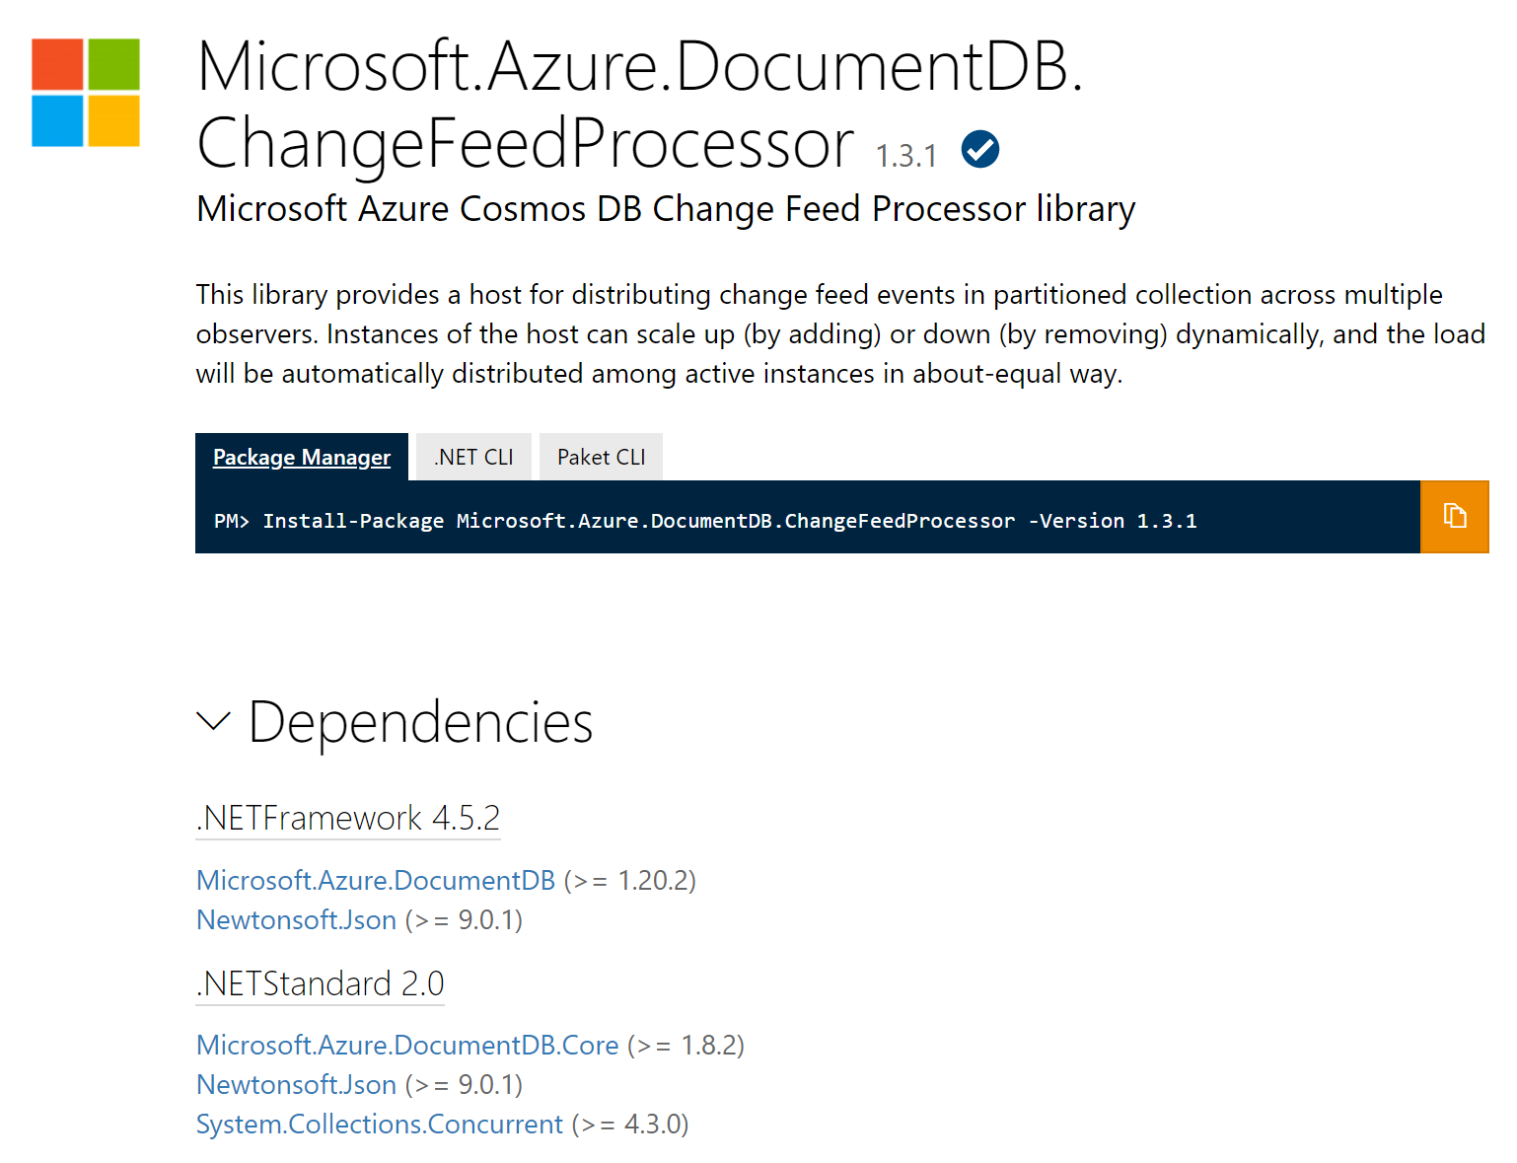
Change Feed Processor Library
https://www.nuget.org/packages/Microsoft.Azure.DocumentDB.ChangeFeedProcessor/

Slide 45
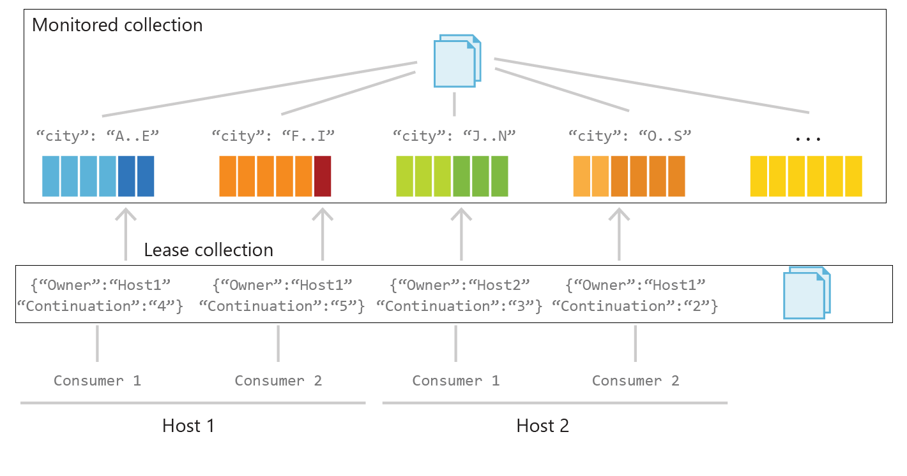
Change Feed Processor –Behind The Scenes

Slide 46
Hands-On Lab
Implementing Azure CosmosDB Change Feed

Slide 47
Thank You
© 2018 Microsoft Corporation. All rights reserved.

